Slide 1
Meeting 15
Monday 11/06/2018

Slide 2
Agenda
BEACon data
Optimization method
6 WT
Different spacing
Next steps

Slide 3
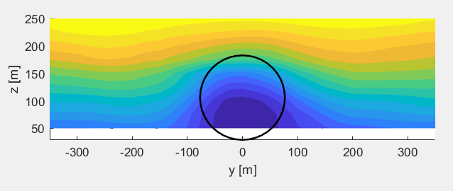
BEACon data
Why not rotor averaged wind speed?
Only 10 vertical planes available
Data from height of 50 m (lowest point of rotor is 29 m)
Non-symmetric wake (and horizontal plane at 100 m) → weighting function not possible
Plane at 100 m height: horizontal profiles

Slide 4
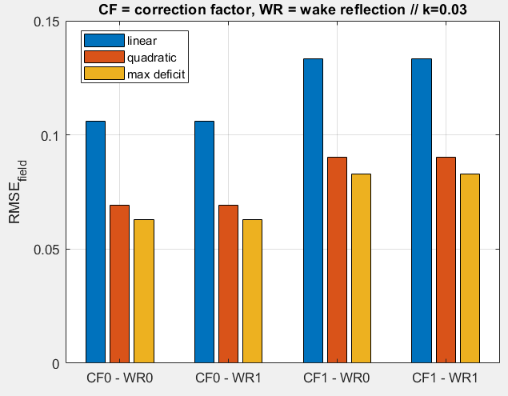
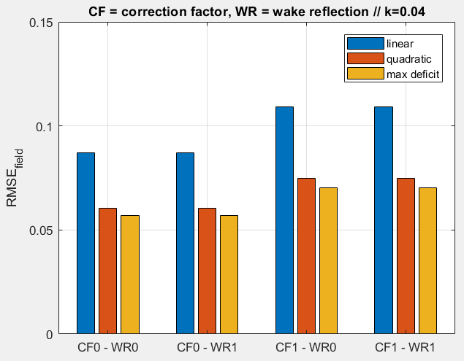
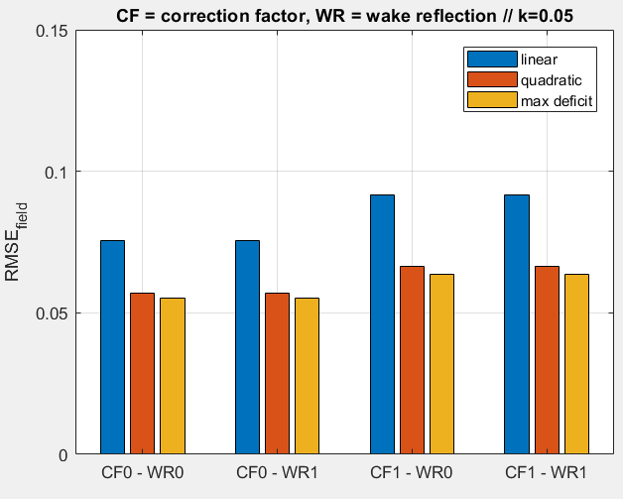
BEACon - Park
RMSE of field (0,97D upstream to 16,2D downstream, +- 1,95D cross-stream)

Slide 5
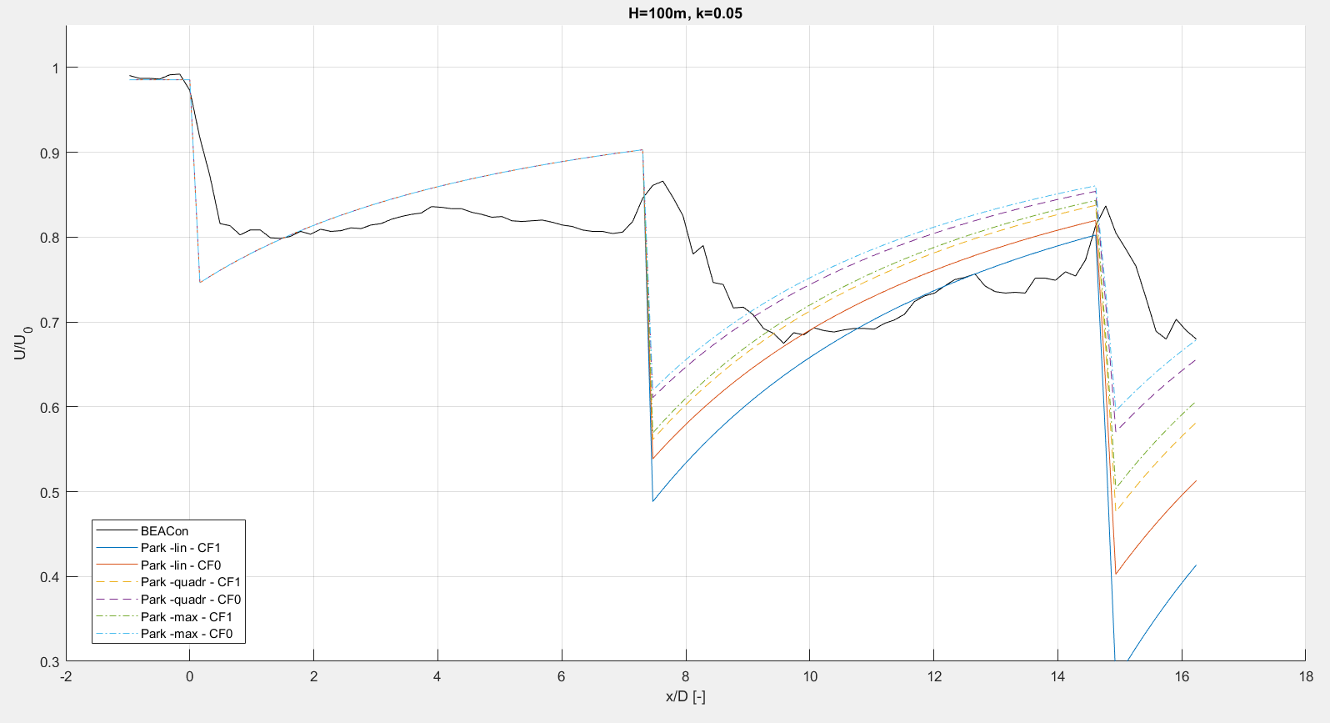
BEACon – streamwise line (Park)

Slide 6
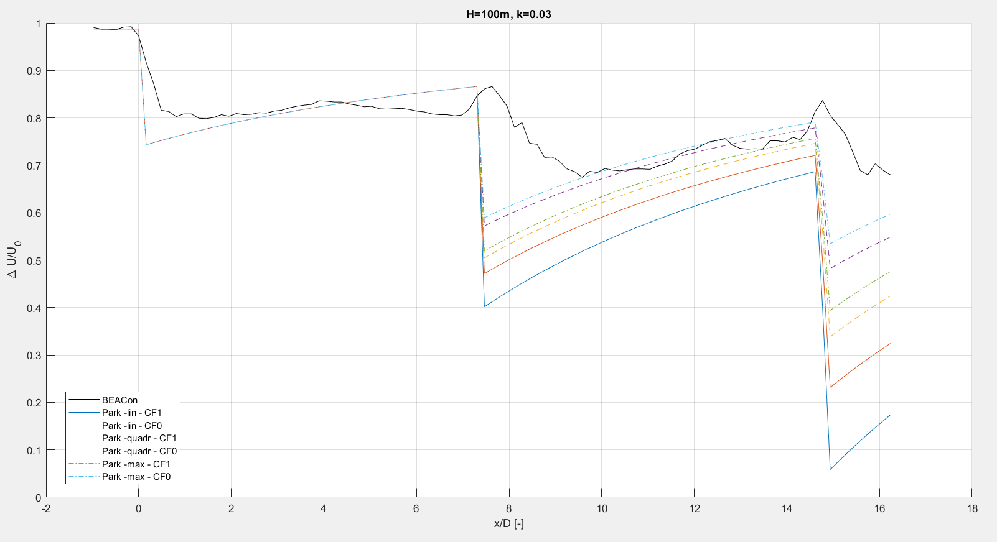
BEACon data – streamwise line

Slide 7
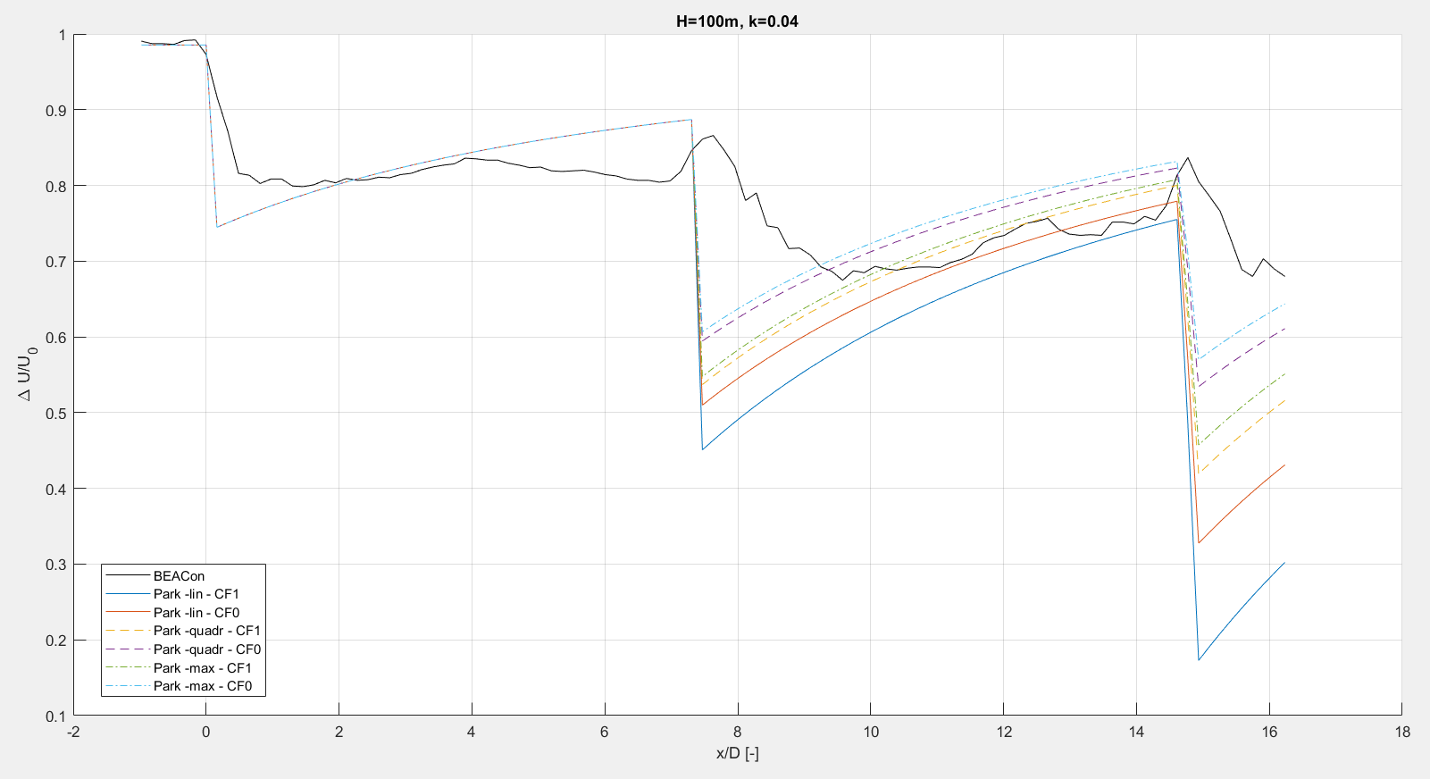
BEACon data – streamwise line

Slide 8
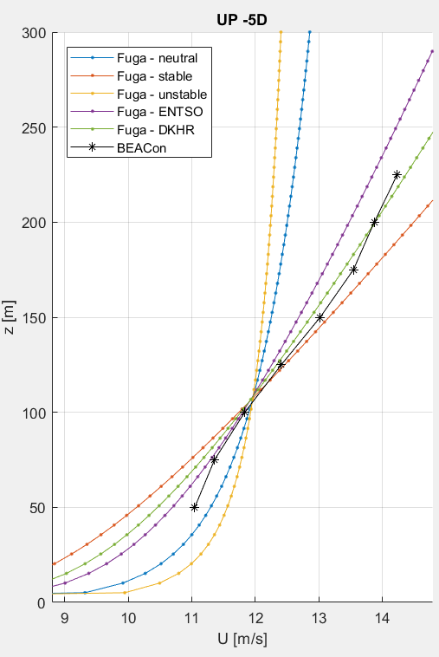
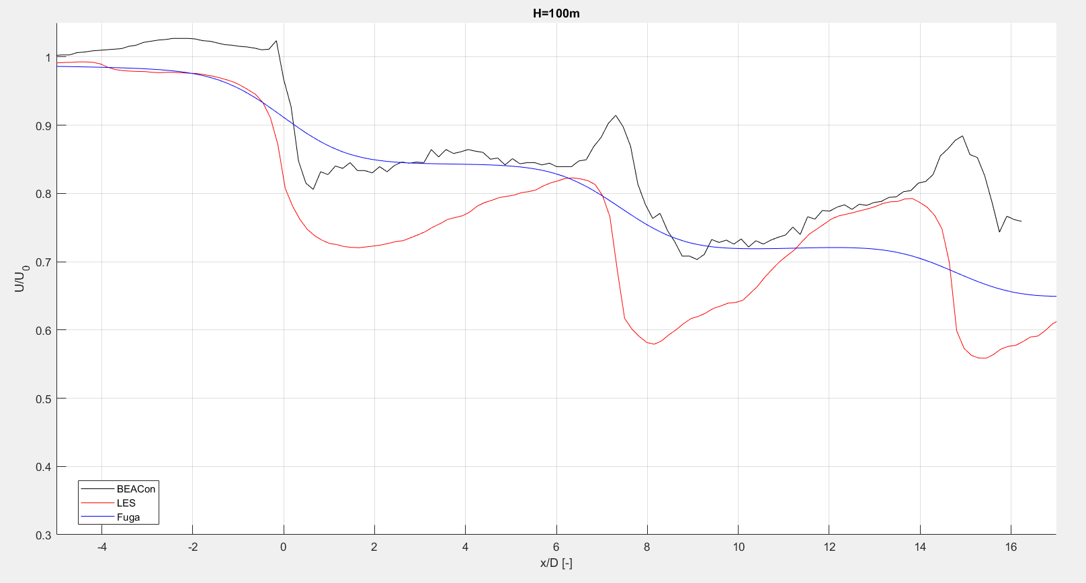
BEACon – Streamwise line (LES & Fuga)
← DKHR inflow profile used for Fuga

Slide 9
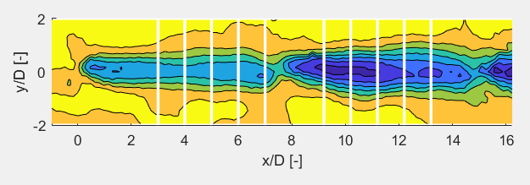
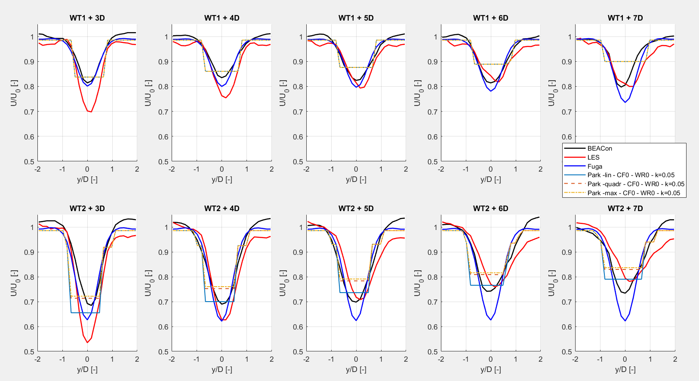
BEACon data – horizontal profiles

Slide 10
BEACon data
Instead of comparing full fields, comparing power at the turbines
Error bar available for BEACon power data?
Longer row?
Nicolai:
Better not to include the BEACon data
Too many unknowns, separate study necassary to find out why the comparison with LES is bad

Slide 11
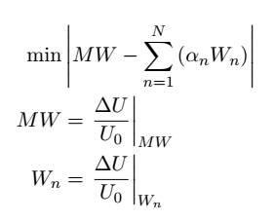
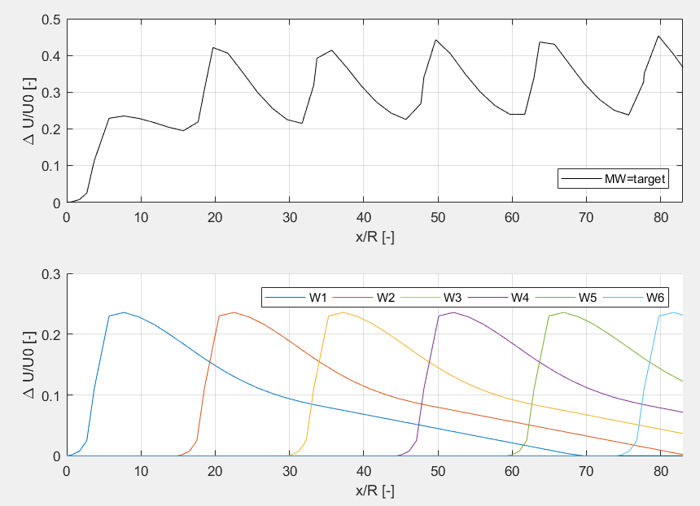
Optimization method – 6WT
(optimization done for the rotor averaged wind speed = the sum of the differences at each location)
Full wake 14 m/s – 6WT – TI 3,5%
Single wake 1 14 m/s – 1WT – TI 3,5%

Slide 12
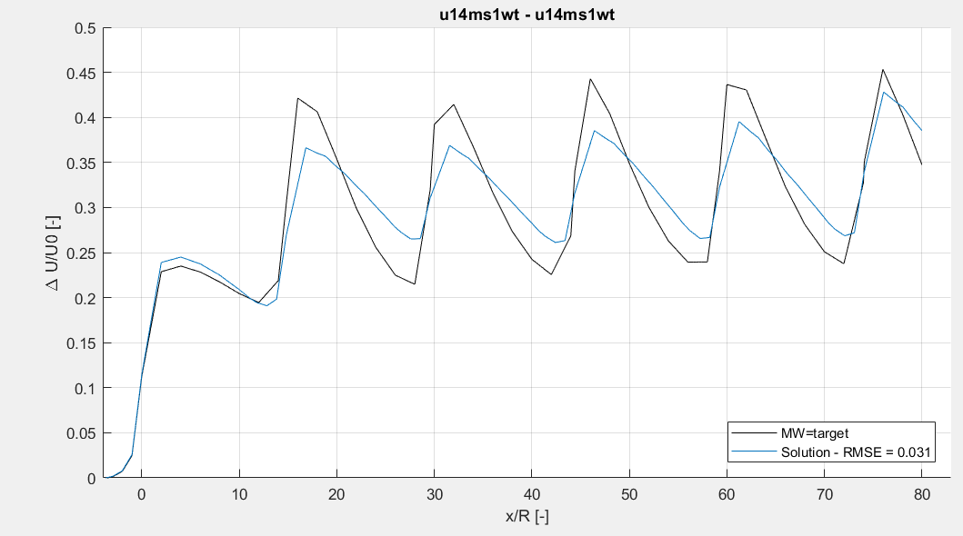
Optimization method – 6WT
Full wake 14 m/s – 6WT – TI 3,5%
Single wake 1 14 m/s – 1WT – TI 3,5%

Slide 13
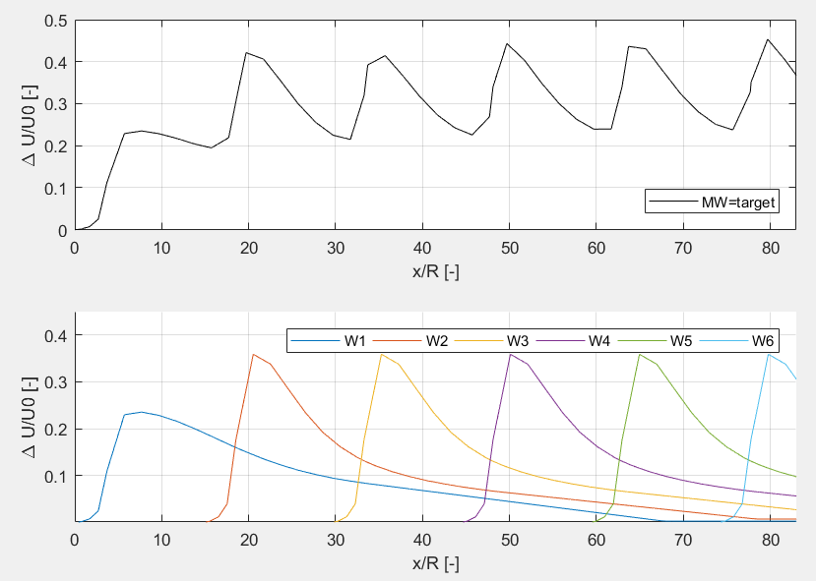
Optimization method – 6WT
Full wake 14 m/s – 6WT – TI 3,5%
Single wake 1 14 m/s – 1WT – TI 3,5% Single wake 2:N 11,2 m/s – 1 WT – TI 8%

Slide 14
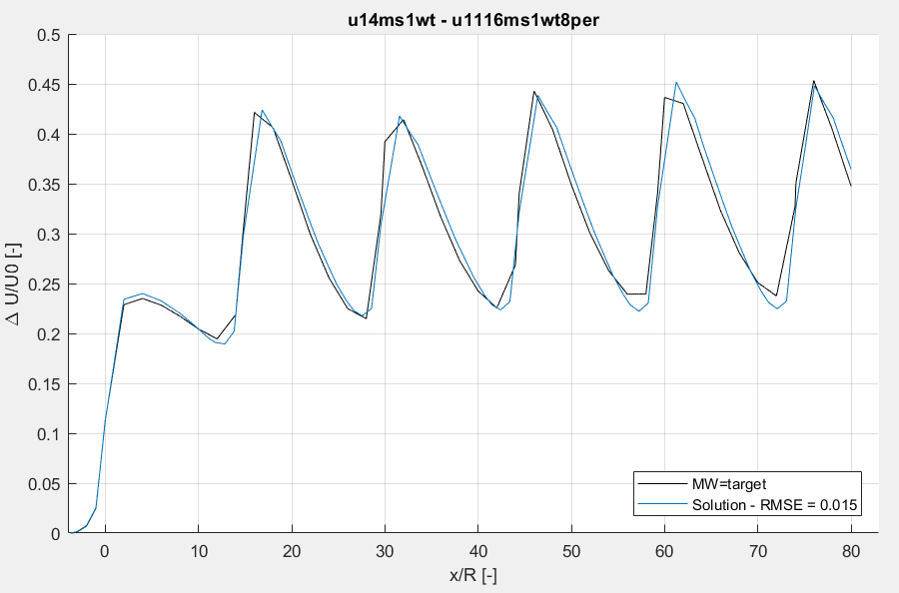
Optimization method – 6WT
Full wake 14 m/s – 6WT – TI 3,5%
Single wake 1 14 m/s – 1WT – TI 3,5% Single wake 2:N 11,2 m/s – 1 WT – TI 8%

Slide 15
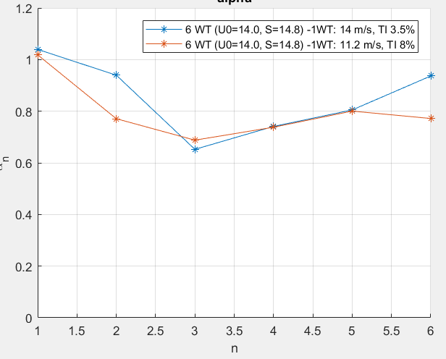

Optimization method – 6WT
Coefficients $α_{n}$
$α_{1}≅1$
$α_{2..n}<1$ Less than linear superposition

Slide 16
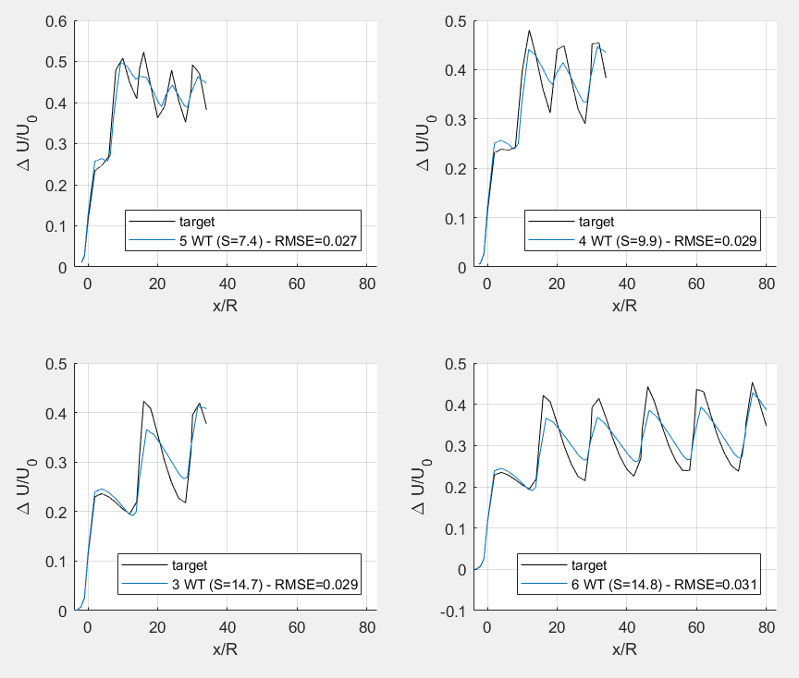
Optimization – different spacing
Full wakes 14 m/s, TI 3,5%
5 WT – S=7,4R
4 WT – S= 9,9R
3 WT – S = 14,7R
6 WT – S = 14,8R
Single wake 14 m/s – 1WT – TI 3,5%

Slide 17
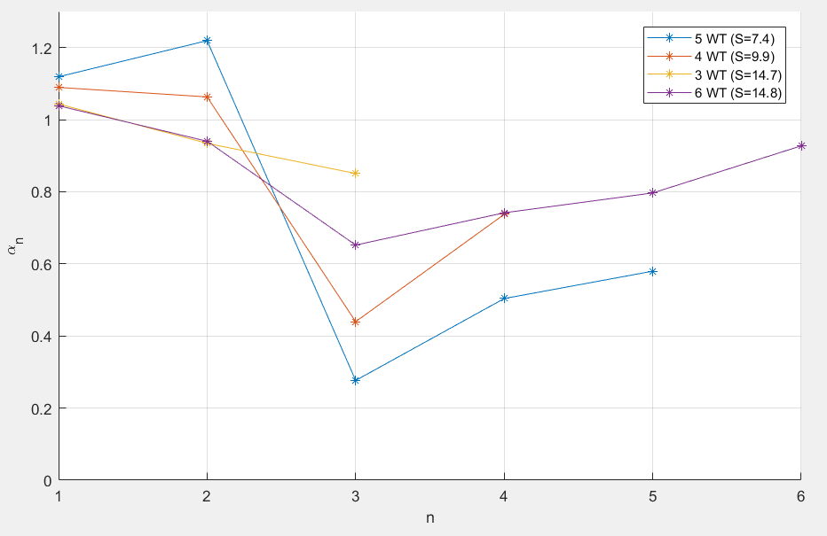

Optimization – different spacing
Do $α$ coefficients converge?
Coefficients will be different for different inflow conditions

Slide 18
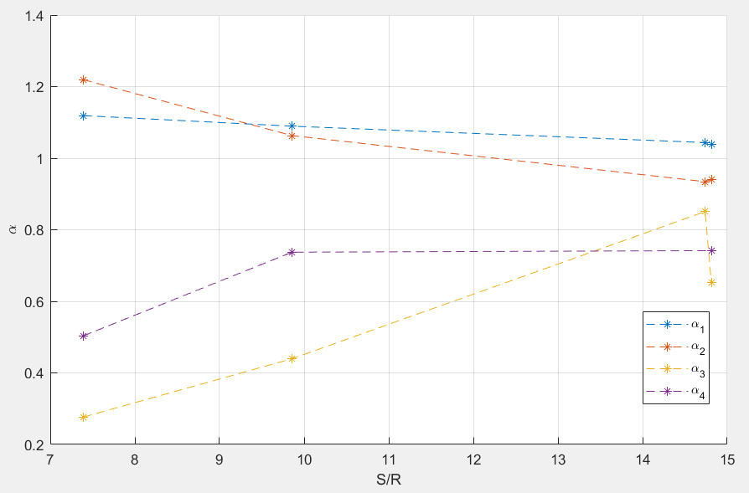

Optimization method – different spacing
Relation between $α$ coefficients and spacing?

Slide 19
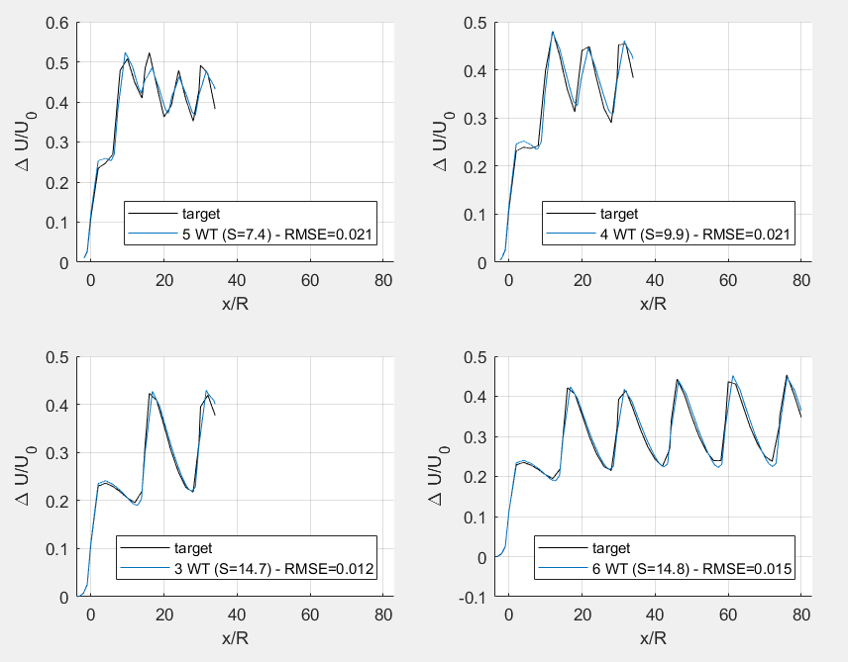
Optimization – different spacing
Full wakes 14 m/s, TI 3,5%
5 WT – dx=7,4R
4 WT – dx= 9,9R
3 WT – dx = 14,7R
6 WT – dx = 14,8R
Single wake 1 14 m/s – 1WT – TI 3,5% single wake 2:n 11,2 m/w – 1WT – TI 8%

Slide 20
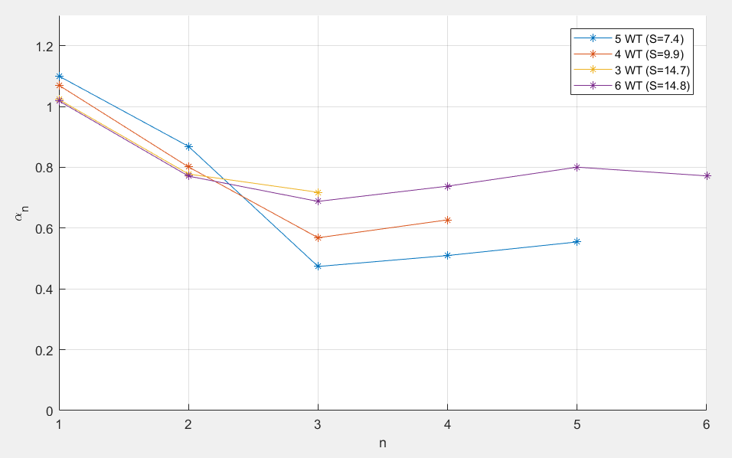

Optimization – different spacing
Do $α$ coefficients converge? (new LES simulation is running for 13 wind turbines)

Slide 21
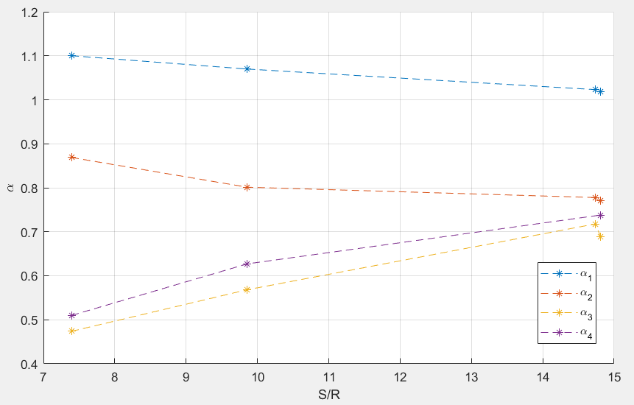

Optimization method – different spacing
Relation between $α$ coefficients and spacing?

Slide 22
Optimization method
What if single Fuga wake is used?
What is single Park wake is used?

Slide 23
Next steps
Optimization method
Coefficients
Comparison of power for BEACon
Final draft: Monday 9/07? Green light?
Final hand-in: Tuesday 31/07
Defence: Wednesday 15/08
Next meeting? Tue 26/6 at 9:00

